Slide 1
Hotel Booking Data Analysis
Presented by: Geeta Sanjay Torane
Guided by: Abhishek Wavhal

Slide 2
Project Summary
To evaluate City Hotel and Resort Hotel's business performance from 2015 to 2017, I conduct an in-depth study of them. This analysis covers operational effectiveness, customer satisfaction, market positioning, financial performance, occupancy and revenue management, sales and marketing tactics, and strategic planning. The goal is to provide meaningful insights to improve operations, increase profitability, and foster sustainable growth for both hotels by analyzing market dynamics and key performance metrics.

Slide 3

Analyzing Data
Data Preparation
Visualization and Reporting Overview
Comparative Analysis

Slide 4
Data Preparation
Cleaning: Remove Errors, Remove blank records and Remove Duplicates, to ensure data integrity. The data cleaning procedures, include further finding NULL values and Replace values for better data interpretation to ensure complete understanding of these steps in preparing high-quality data for analysis.

Slide 5
Visualization and Reporting Overview
Introduction to the importance of visualization and reporting for delivering effective analysis to stakeholders. The project delivers an interactive, visual reporting solution that transforms raw project data into actionable insights, utilizing tailored dashboards for tracking KPIs, monitoring timelines, and analysing resource allocation to support data-driven decision-making.

Slide 6
Comparative Analysis
Explore our comparative analysis of City Hotel and Resort Hotel.
Discover key strengths, weaknesses, and strategies of this his report presents a comparative analysis of booking patterns between city hotels and resort hotels. The objective is to provide clear insights into customer demand, seasonality, and occupancy trends across both hotel types. By analyzing key booking metrics, this dashboard helps stakeholders understand performance differences and supports data-driven decisions to optimize pricing, marketing strategies, and resource planning. And future opportunities for both Hotel

Slide 7
Expected Outcomes
1.Improved Decision-Making
The project aims to assist hotels in making more informed choices to enhance guest experiences.
2. Decreased Cancellations
It will identify the reasons behind guest cancellations and work towards minimizing them

Slide 8
3. Strategic Positioning
Analyzing the project will give hotels insights into their position compared to competitors, enabling them to position themselves in the market strategically.
4. Long-Term Strategy:
This initiative will assist hotels in developing a long-term strategy by identifying trends and opportunities for growth in the future
5. Improved Operational Planning :
This will helps for better understanding of resources allocation and track the demand supply patterns.

Slide 9
About Data
1.Booking information
2.Guest Details
3.Booking History
4.Room Information
5.Financials and Extras
6.Booking Channel
7.Reservation status

Slide 10
1.Booking Information
Hotel Type: Resort or City
Cancellation Status: Booked (1) or Cancelled (0)
Lead Time: Number of days between booking and arrival
Arrival Details: Year, Month, Date, Week number
Duration of Stay: Number of weekends nights , Number weekdays nights

Slide 11
2.Guest Details
Guest Breakdown: Adults, Children, Babies
Country : Country of guest coming from
Client Category: Specific four groups
Returning Guest: Yes (1) or No (0)
Meal Choice: Meal type reserved

Slide 12
3.Booking History
Previous Cancellations: Number of past cancellations
Number of confirmed bookings: Number of past non-cancelled bookings

Slide 13
4.Room Information
Type of Room Reserved: Code for the room type that was reserved
Type of Room Assigned: Code for the room type that was assigned
Changes to Booking: Total number of modifications made to the reservation

Slide 14
5.Financial and Extras
Average Daily Rate (ADR): Calculated price per day
Deposit Type: Type of deposit made by customers
Required Extras: Number of car parking spaces, specific requests

Slide 15
6.Booking Channel
Market Segment: Classification based on booking trends
Distribution Channel: Method of distributing bookings
Agent/Company ID: Unique identifier for booking agents or companies.

Slide 16
7.Reservation Status
Number of Days in Waiting List: Duration on the waiting list
Current Reservation Status: Present booking status
Last Update of Reservation Status: Date of the most recent status change

Slide 17
Problem Statement
The dataset consists of booking information for a city hotel and a resort hotel, including the booking date, number of adults, children, and babies, available parking spaces, booking agent, and other relevant information. This project examines and analyzes the data to determine important factors affecting bookings.
What is your objective for the business?
We will analyze and visually represent the booking data for both the City Hotel and Resort Hotel to better understand the different factors that influence the bookings and the Average Daily Rate (ADR).

Slide 18
Data Cleaning Steps
During the Exploratory Data Analysis, various pre-processing steps were implemented to ensure data cleaning
In next slide shown,
1. Perform steps of data cleaning
2. Total Column Name headings
3. Operations perform during data cleaning explain

Slide 19
ROWS | COLUMNS | EFFECT
119390 | 32 | Total Records
119386 | 32 | Remove 4 errors
119386 | 32 | Remove 0 blanks
87392 | 32 | Remove 31994 duplicates
87392 | 31 | Null values in Agent & country, company deal
87392 | 32 | Arrival date column added ( by merging arrival Date, month & year column)
87392 | 28 | Deleted 3 columns (above merge columns) and also deleted Days in waiting list column
87392 | 27 | Arrival week number column deleted
87220 | 28 | Added total number of people column & remove errors in that column
87220 | 29 | Added total stay column
87220 | 30 | Added satisfaction level column
87220 31 Added Booking ID column

Slide 20
Columns after performing EDA process
1.Booking ID | 10. Children | 20. Reserve room type | 28.Total of special requests
2.Hotel | 11. Babies | 21. Asssigned room type | 29. Reservation status
3. is_cancelled | 12. Total number of people | 22. Booking changes | 30. Reservation status date
4.lead time | 13. Meal | 23. Deposite type | 31. Satisfaction level
5. Arrival date | 14. country | 24. Agent
 | 15. Market segment
6. Stays in weekends night | 16. Distribution channel
7.Stays in week nights | 17. Is repeated guests | 25. Customer type
8. Total stay | 18. Previous cancellation | 26. Adr
9.Adults | 19. Previous bookings not cancelled | 27. Required car parking spaces

Slide 21
Merged columns Adults, children and babies into a column called [Total number of people].
Replaced NULL in the Agent column by Direct booking , Country colum by self country.
Removed Company column as 93% in the column were NULL.
Remove the Days_in_waiting_list column, as most values were NULL.
Replaced Undefined values in the Meals column with Others
Added index column and custom column “Booking-ID-” merging this two columns created new column called Booking ID.
Remove index and custom column.

Slide 22
Data Visualization and Analysis

Slide 23
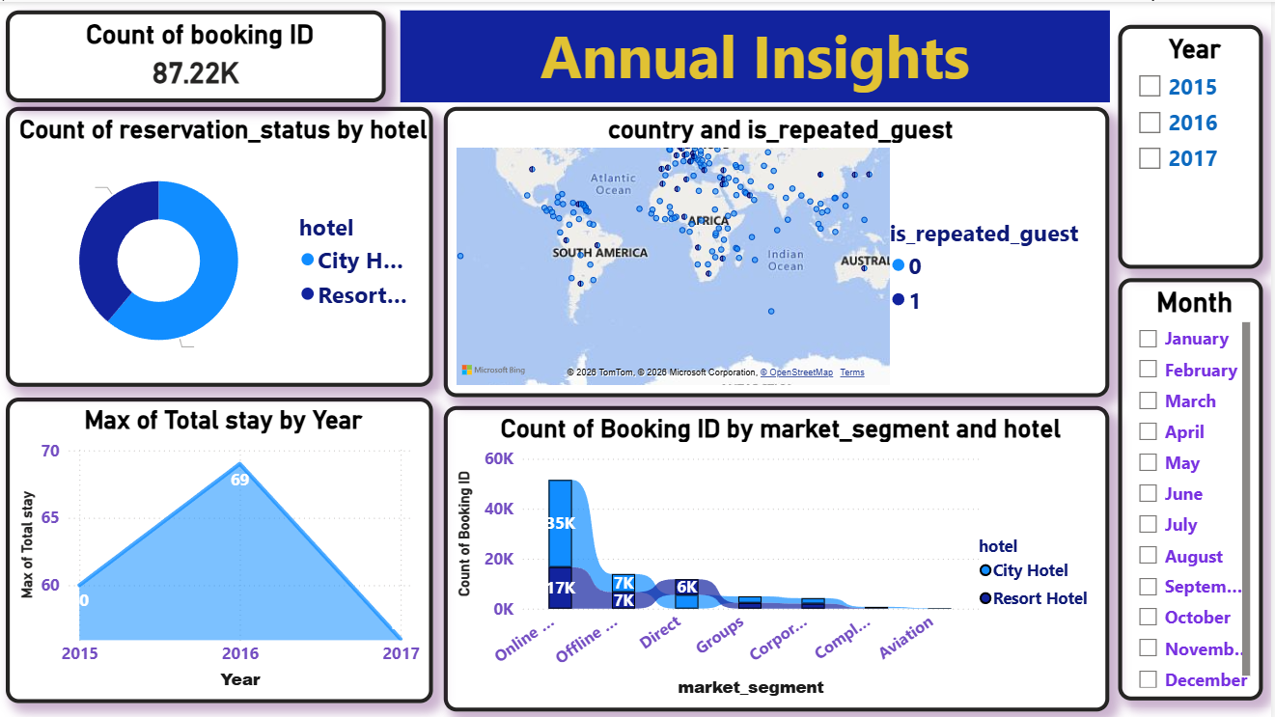

Slide 24
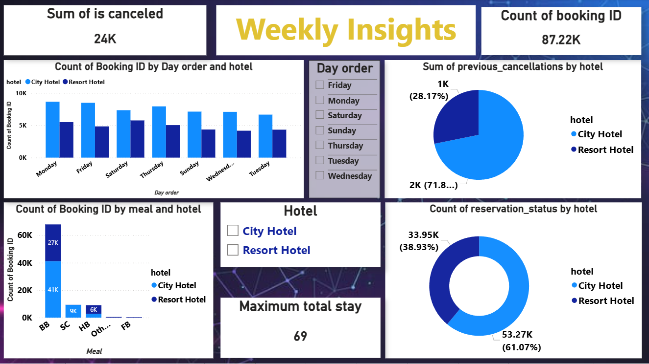

Slide 25
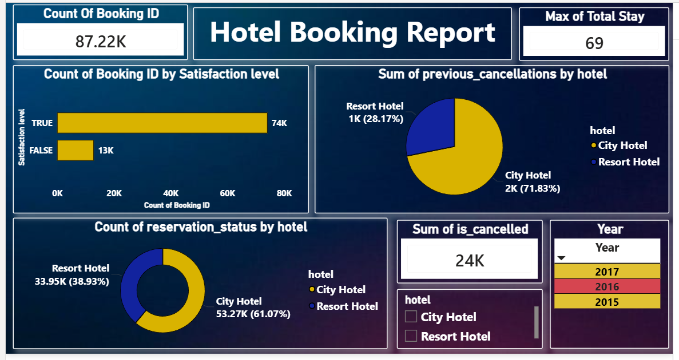

Slide 26
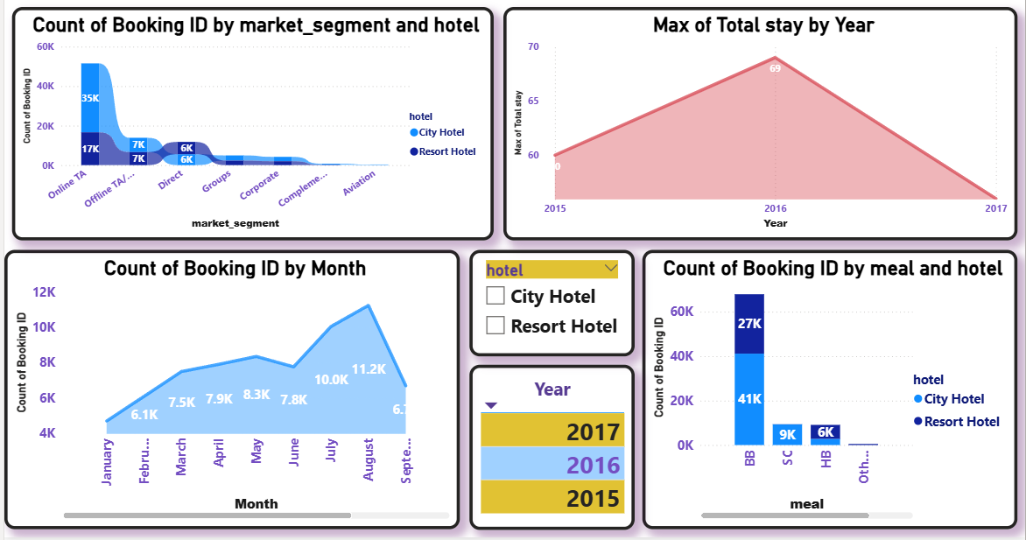

Slide 27
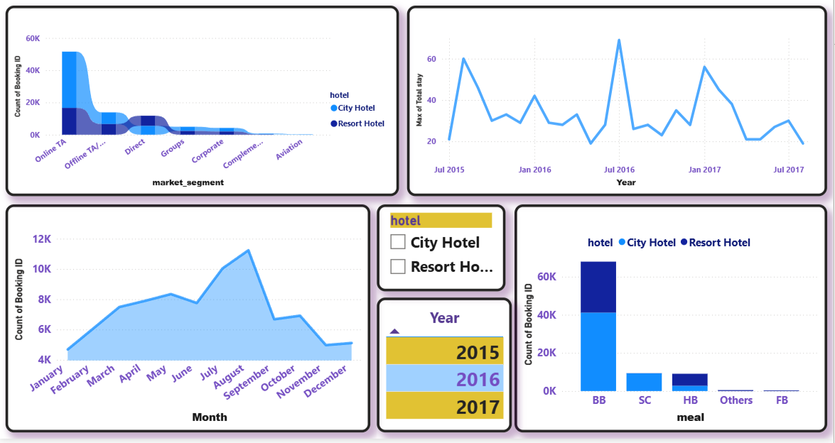
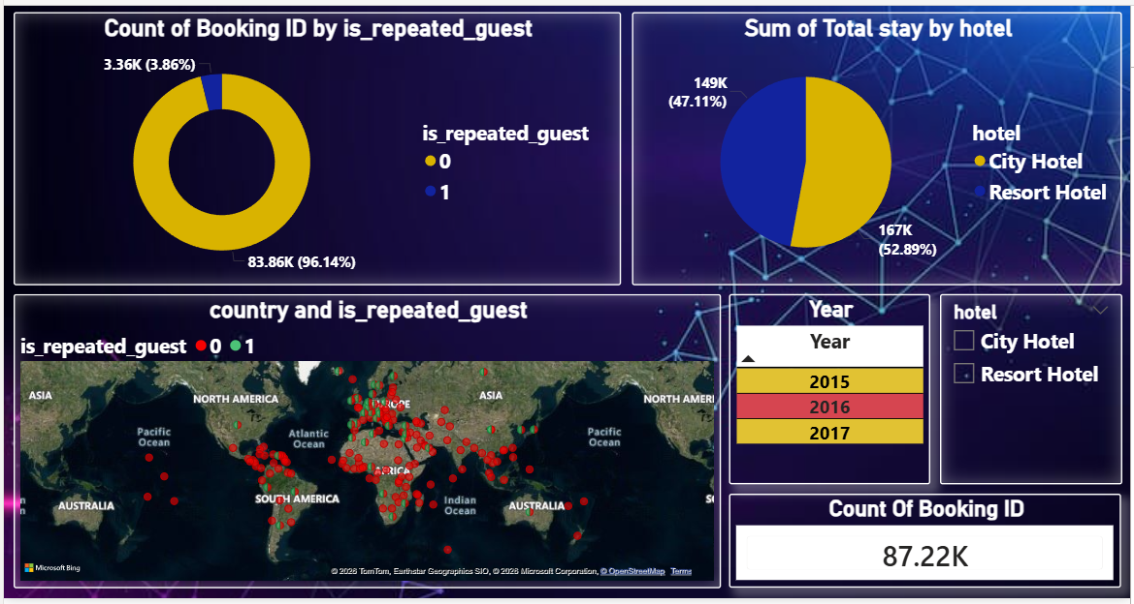

Slide 28
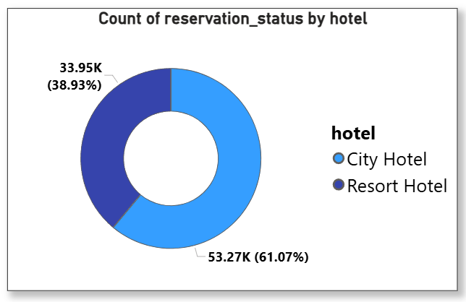
Based on this pie chart,
The total count of reservation status by City hotel is maximum that is 61.07% and Resort hotel having 38.93% of reservation.
The difference between 53.27K and 33.95K shows majority of customer preferring reservation in City hotel.

Slide 29
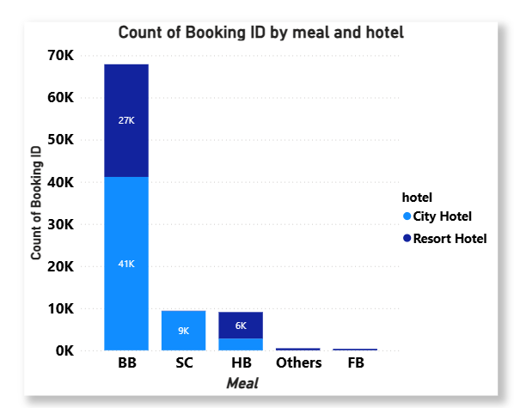
The stack bar chart shows the number of guest book their hotel are preferring BB meal type that is maximum in city hotel 41K and in resort hotel is 27K
HB meal 6K in resort hotel prefer
SC meal 9K prefer in City hotel

Slide 30
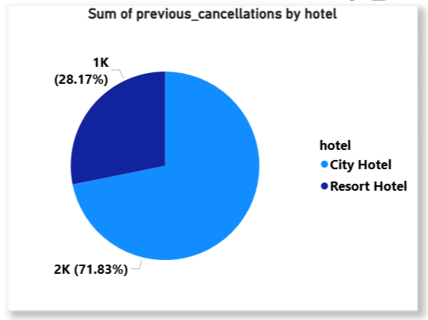
The sum of previous cancellations by city hotel is 71.83% and by resort hotel is 28.17%
Based on these observations we can say that city hotel has higher number of booking but it also has higher number of cancellations

Slide 31
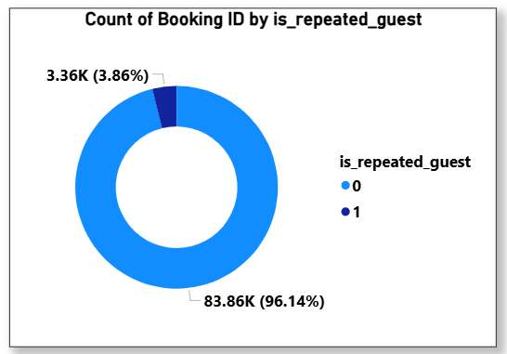
The total count of Booking ID IS 87.22K out this 83.86K repeated guest
Only the 3.36K guest not repeated, donut chart says
This shows the guest prefer your hotel over other competitive partners.

Slide 32
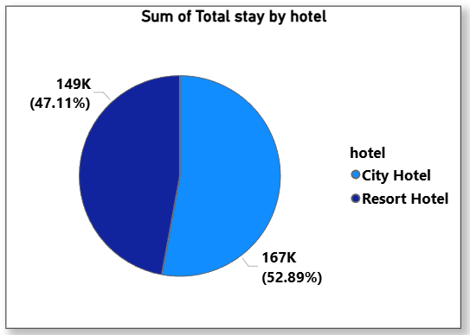
The 167K means the 52.89% of number of people stay in city hotel and remaining 149K i.e. 47.11% stay in resort hotel
The difference is approximately only 5% so here we can attract guest by providing best services.

Slide 33
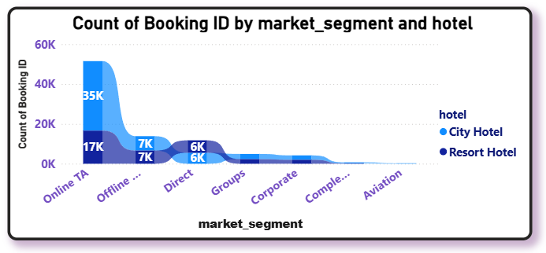
Ribbon chart showing, The market segment occupied with the city hotel 35K and 17K by resort hotel for online TA
And offline TA/TO 7K by both city and resort hotel
Direct booking by both hotels is 6K
Overall online TA preferable.

Slide 34
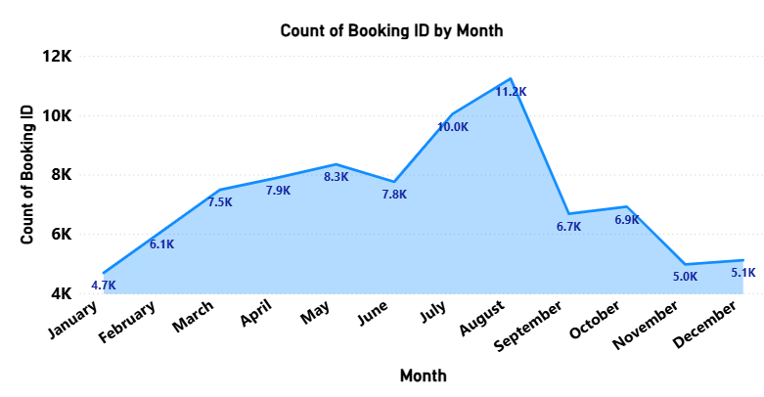
Stacked area chart representing the monthly booking by guest in hotels
The maximum booking in the august month is 11.2K
AND minimum booking in month of January
The chart tells us that trend of booking is July and august is peak period

Slide 35
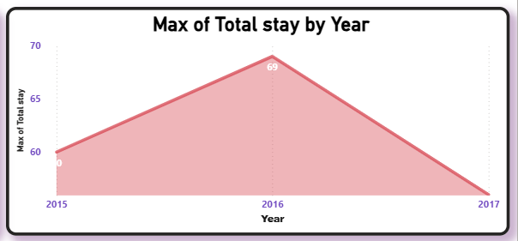
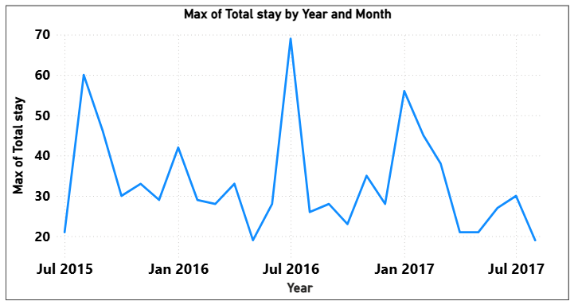
The area chart and line chart having year and maximum of total stay
The July 2016 showing highest 69 total stay by weekends nights and week nights together

Slide 36
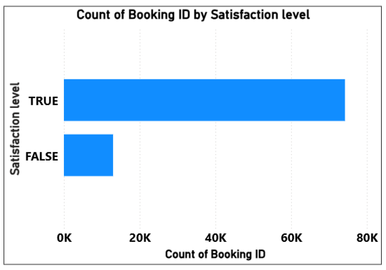
The guest visiting hotels has satisfaction level high representing in stacked bar chart, the value is true.
Approximately 60K-70K by total count of booking ID

Slide 37
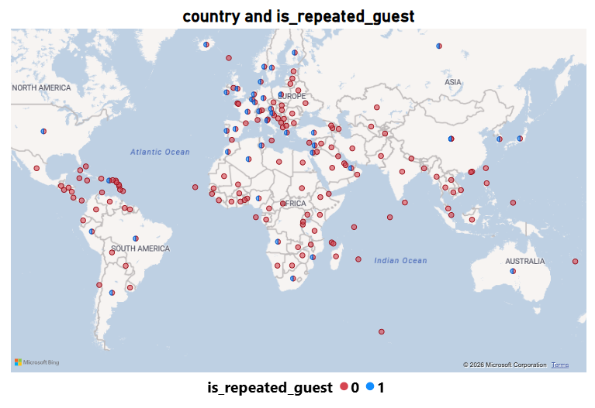
The Map shows from which country the maximum number of guests visit.
Based on the map, we can say that most guests visit from Portugal, the UK and France, i.e., approx. 27.45K, 10K and 9K people respectively.

Slide 38
Conclusion
City Hotels has a higher overall booking rate than Resort Hotels. To improve this, Resort Hotels should implement best services.
The City Hotel has a higher rate of cancellations than Resort Hotels. By implementing focused strategies could retain guests,.
August is one of the peak months for bookings. Hotels should manage their resources during these months.
By promoting early-bird specials, hotels can encourage reservations well in advanced.
Focusing on ‘BB’ as the preferred meal choice also survey the meal choices requirements.
The low rate of returning guests highlights the opportunity for implementing better hospitality to increase the number of repeat stays.

Slide 39


